Slide 1
Action Module with examples

Slide 2
Scope
Session 1: Presenting the Action module. A presentation only.
Session 2: Defining Actions. Using XML to create and modify Actions in your own environment. Conclude with an agreed assignment after class.
Session 3: Re-union with Q&A to discuss and clarify issues surfaced during the home assignment.

Slide 3
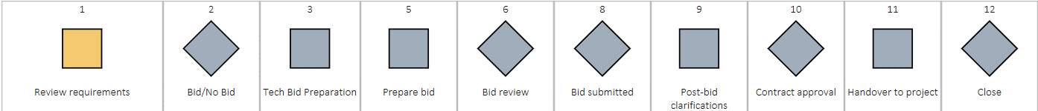
A Highstage module
Unlike Document, Part and Device modules the Action module can be used to model any process (Change, Project, CAPA, Complaint etc.)
3

Slide 4
Behavior overview
 | Documents | Actions
Revisions | X | -
Reviewers/Approvers | X | -
Manager | - | X
Sequence | - | X
Deadlines | - (schema) | X
Resources | - | X
Process | - (review/appr.) | X
Can implement procedures (SOP’s) | - | X
Requires document file | X | -
Enforce document/records production | - | X
OVERVIEW

Slide 5
LINEAR SEQUENCE FOR ANY PROCESS
Current
Activity
Activity
Activity
Activity
PROCESS
LIFECYCLE
Milestone
Milestone
Milestone
Follows a linear sequence (Stage Gate Model)
5

Slide 6


Manage processes
Define steps and gates according to procedure
Define document suggestions and requirements for each step
Acquire metadata for each step
Provide guidance and requirements

Slide 7
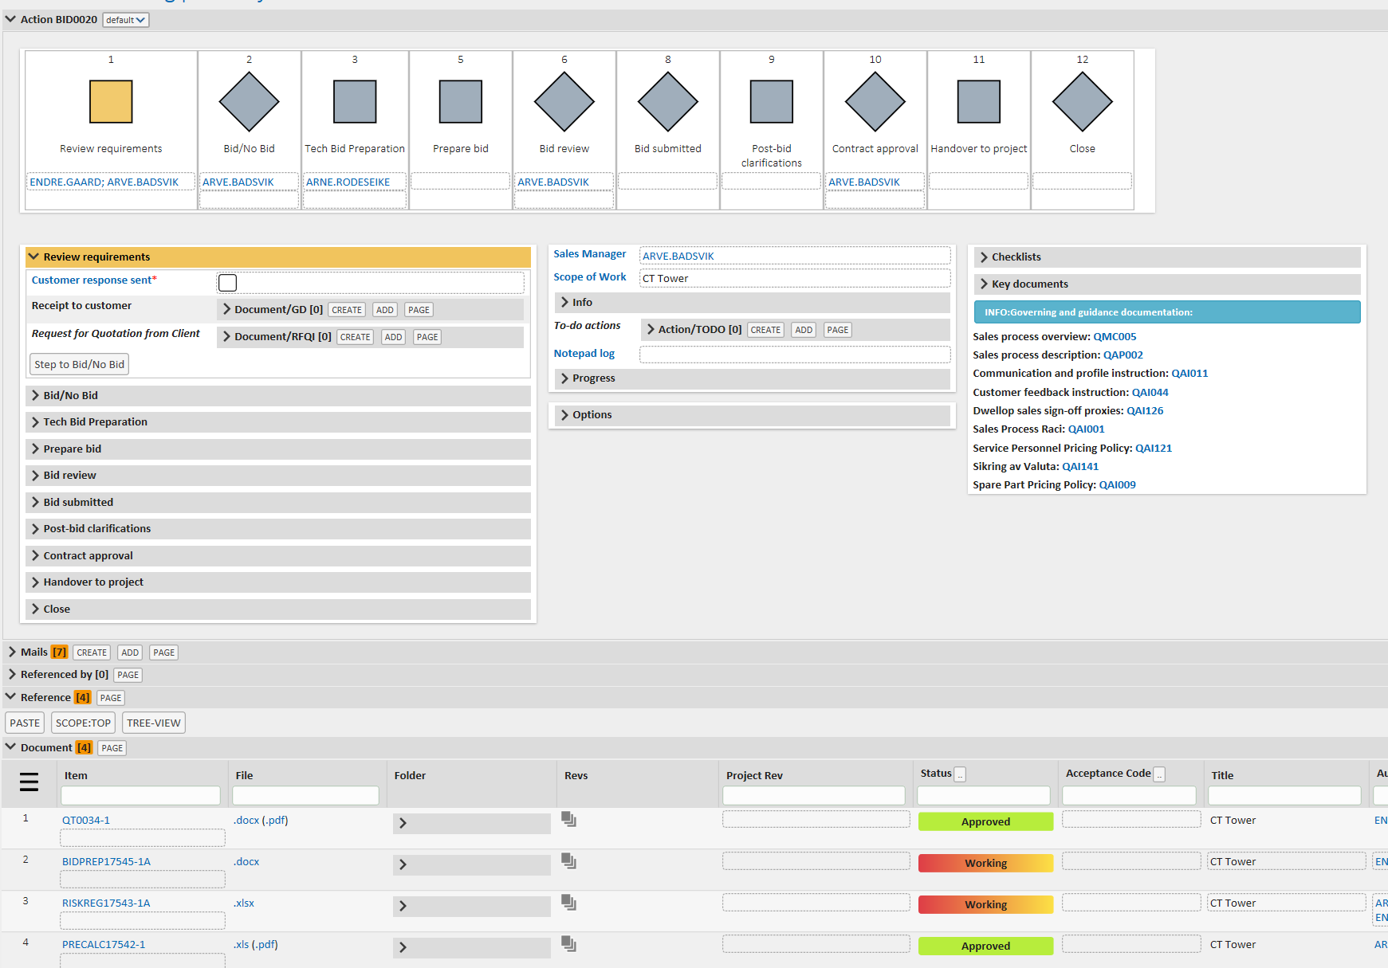
Action overview
All defined in
subtype schemas
Stage gate
Step
Custom step details
Custom information. E.g procedure refs
Step
Associated Emails &
References

Slide 8
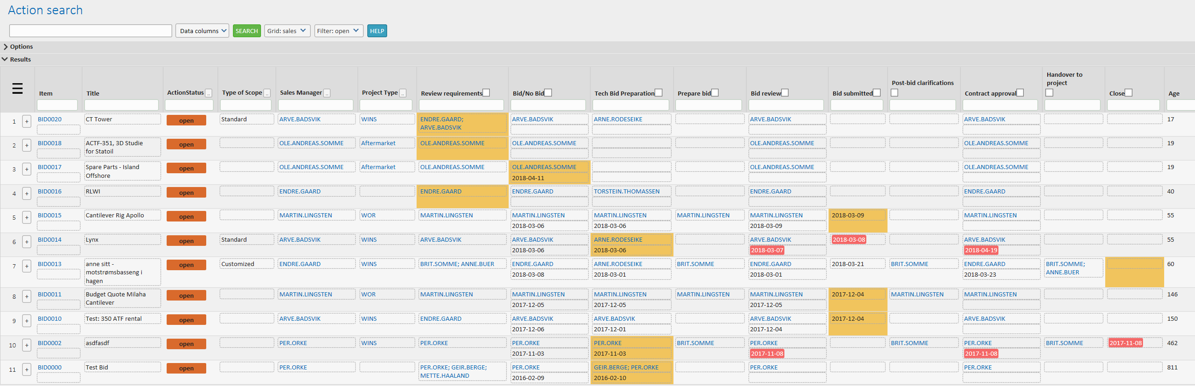
Full overview and control

Slide 9


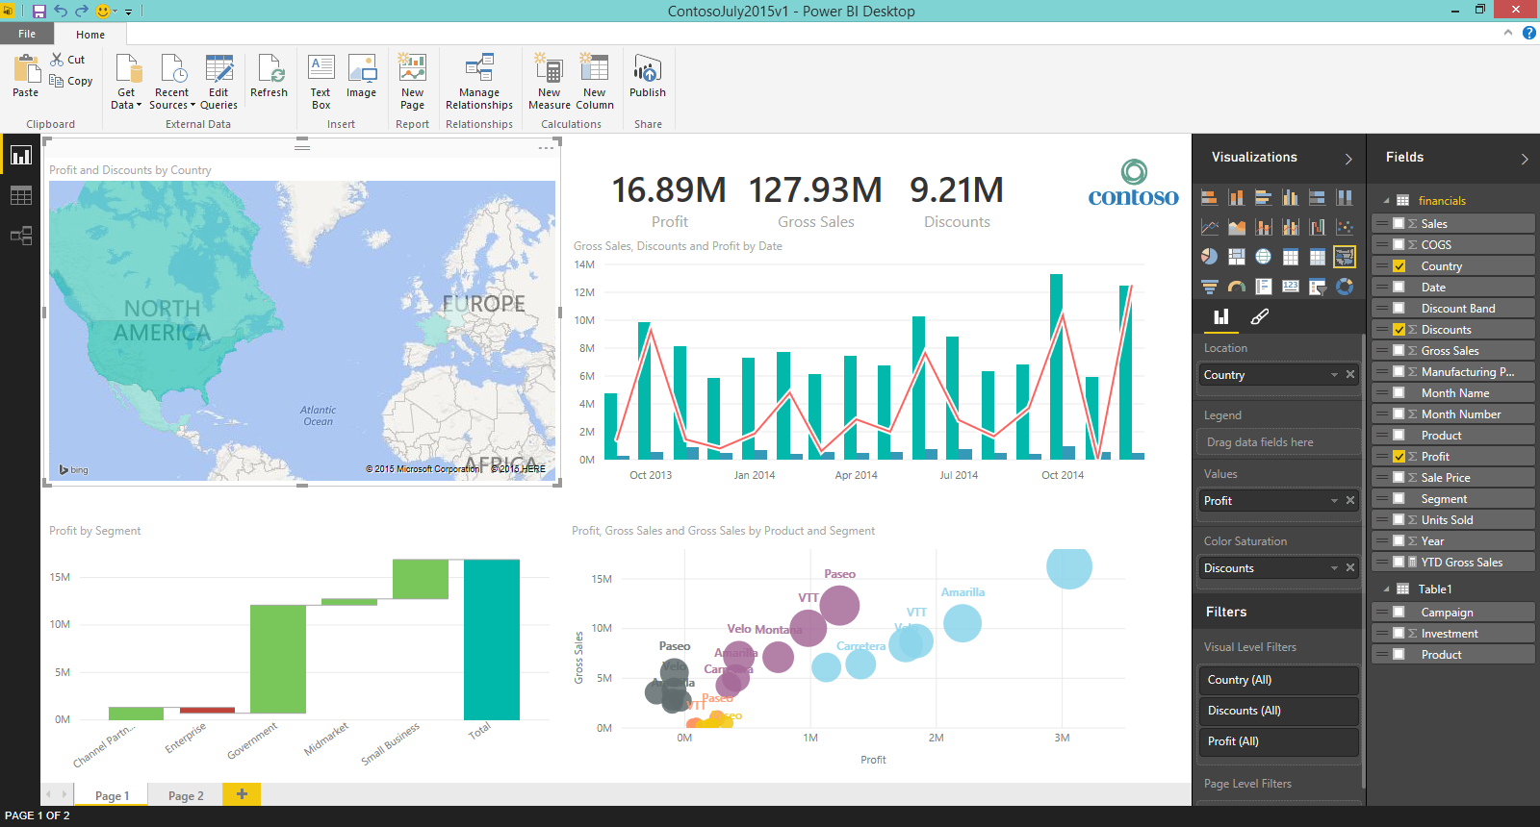
Business Intelligence

Slide 10


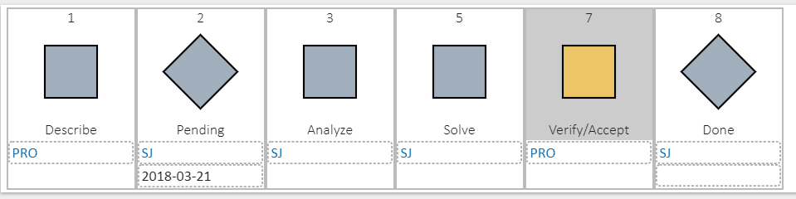
SUPPORT EXAMPLE
Action create from mail
Support@highstage.dk
New Support mails
Create Support Action

Slide 11
Create any number of Action processes with….
Between 1 – 16 steps for each Action process
Assign any number of select users to be responsible for completing each individual step with optional deadlines.
Define whether any number of mandatory and/or optional Documents, Actions, Parts, Devices etc. should be created and completed in each individual step.
Define any number of mandatory and/or optional fields to be filled in each step.

Slide 12

Why use Actions?
  Deploy/enforce corporate best practices
  Improved overview and control
  Improved compliance
  Implement procedures

Slide 13
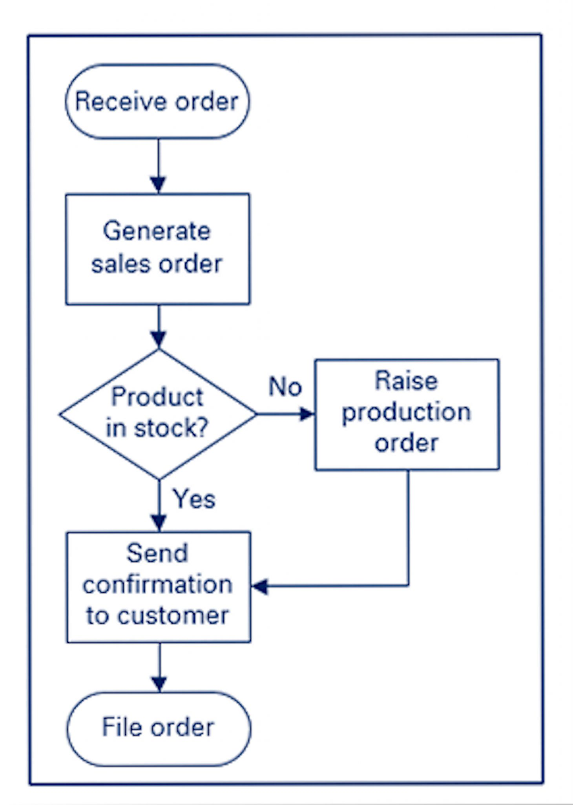
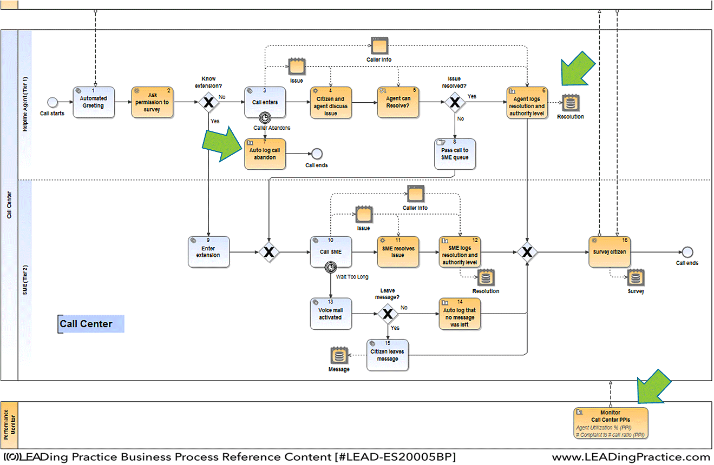
Other common and more complex models
Flowchart
Decision branching
Media
Parallel paths
BPML Business Process Modelling Language
Swim lanes
Organization and technology sensitive

Slide 14
Action Module
ECO examples

Slide 15
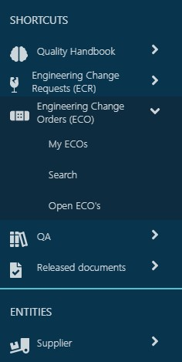
ECR/ECO examples
ECR are used to evaluate and decide on the change
ECO is spawned from ECR if ECR is approved
ECO can change release status of parts (may be the only way to alter release status)

Slide 17
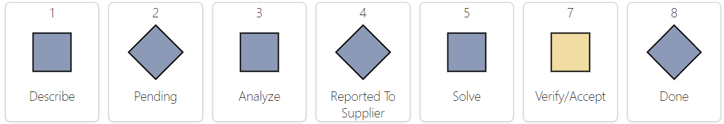
ECR sample – Product Defect

Slide 19
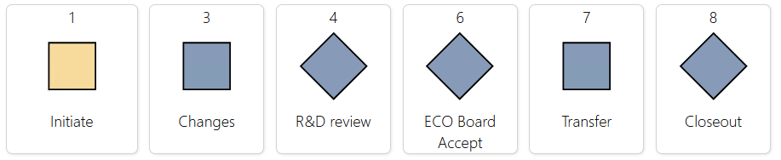
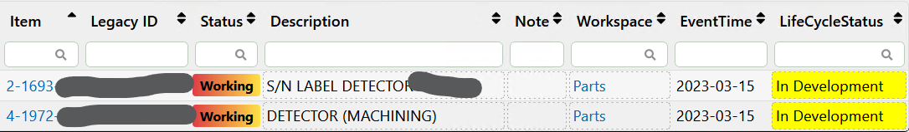
Product ECO - Initiate – Start work

Slide 20
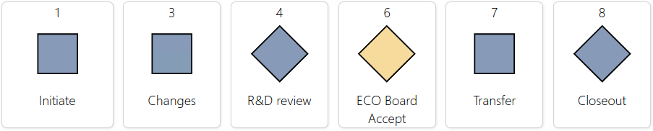
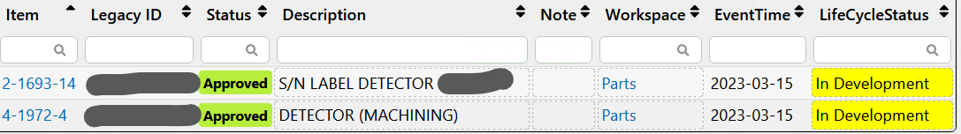
Product ECO - Board Accept

Slide 21
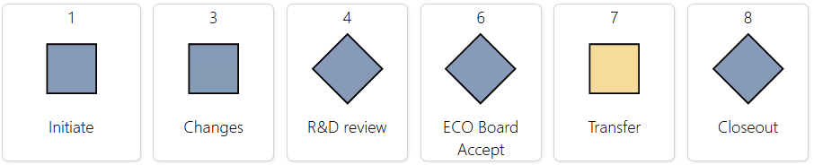
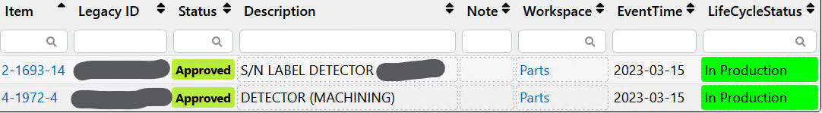
Product ECO - Transfer parts to production
Transition to Transfer stage sets LifeCycleStatus

Slide 22
Action Module
Manufacturing logistics and traceability examples (medtech)

Slide 23
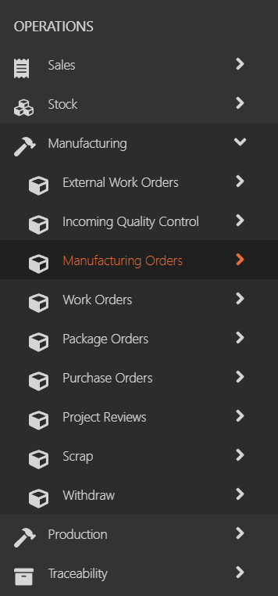
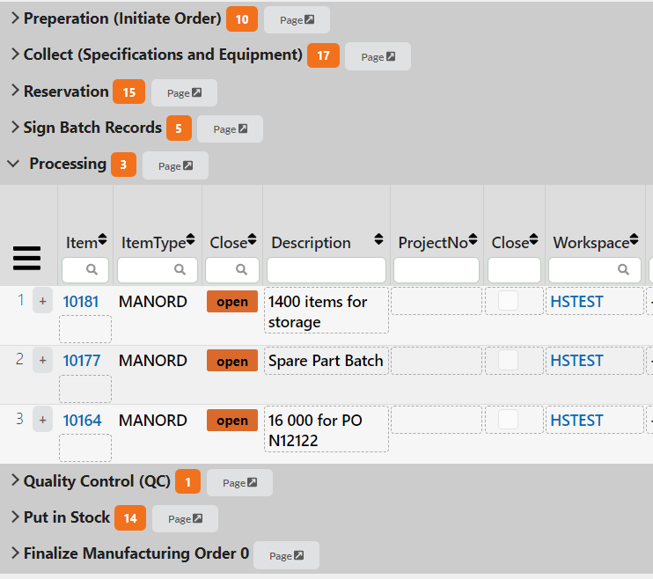
Manuf. Logistics and traceability examples
Manufacturing Work order has got «transitions» in stage promotions
«Transitions» perform work like
  Move goods from one storage location to another
  Adds/removes from stock
  Depleats remaining stocks
  Scraps stock items base on non-con

Slide 24
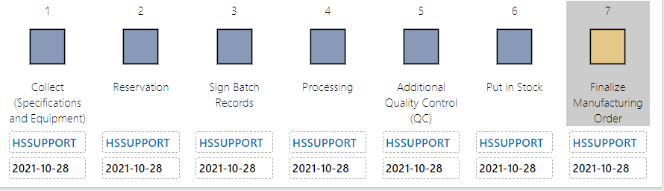
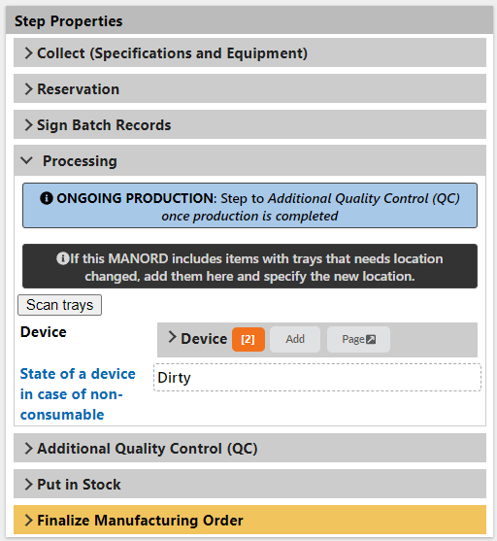
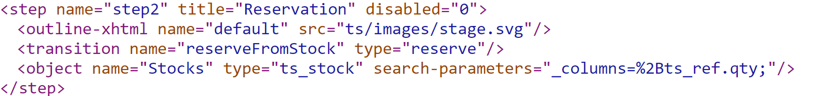
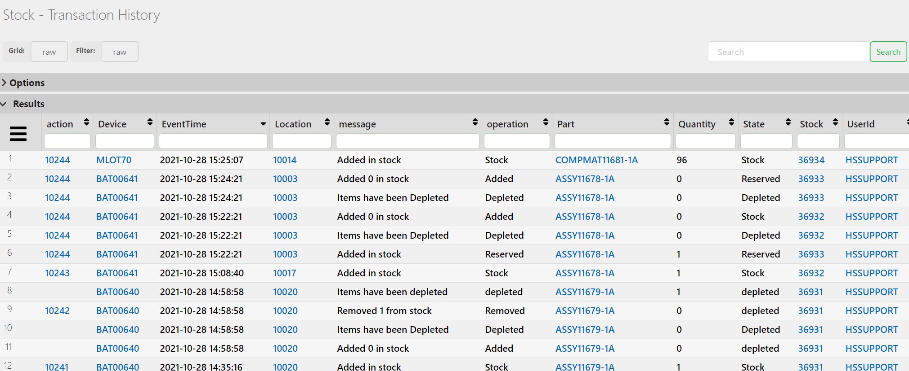
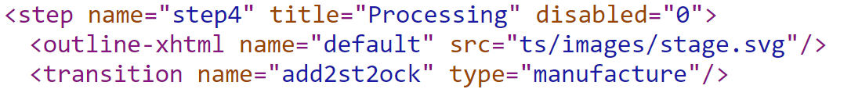
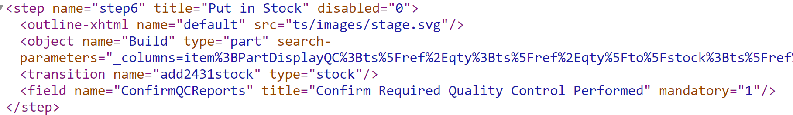
Manufacturing work orders (medtech)
Actions

Slide 25
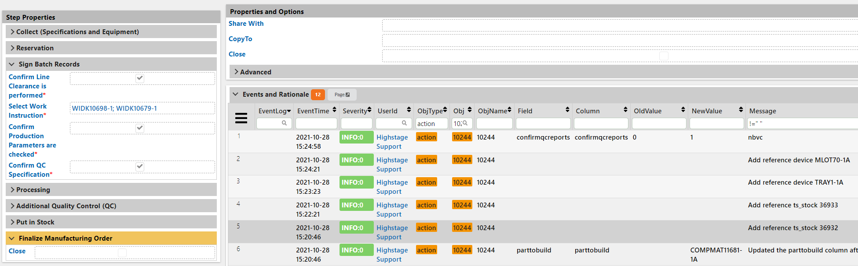
Manufacturing work orders (medtech)
Actions

Slide 26
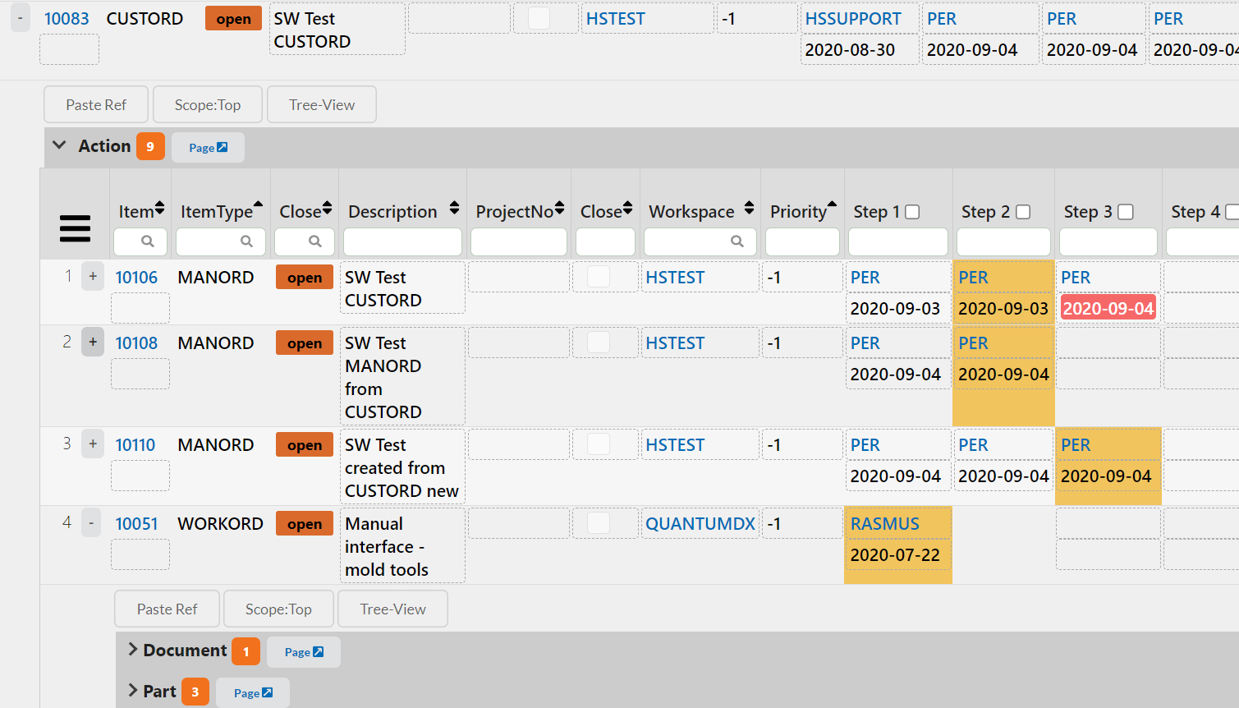
Manufacturing work orders (medtech)
Actions

Slide 27
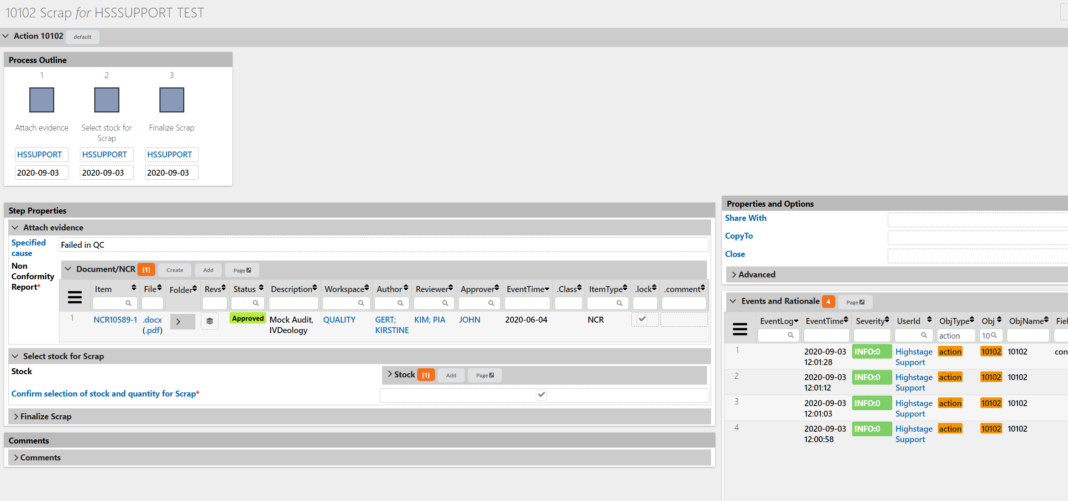
Non-con to Scrap handling (medtech)

Slide 28
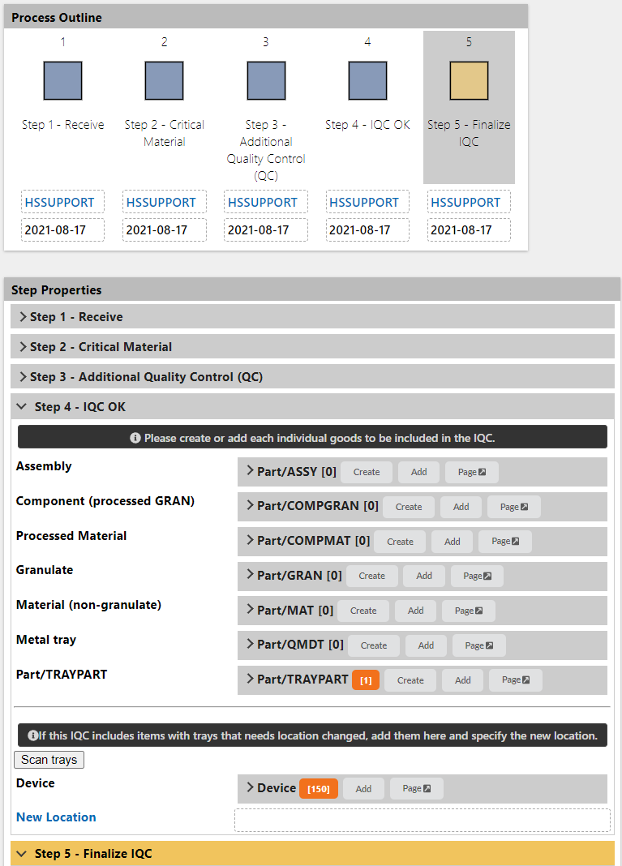
Incoming quality control (medtech)
Actions

Slide 29
Action Module
Project management examples

Slide 30
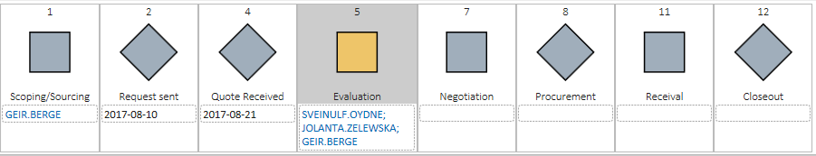
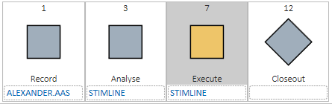
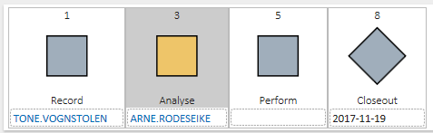
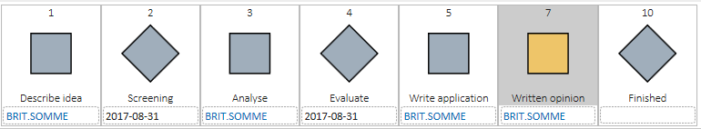
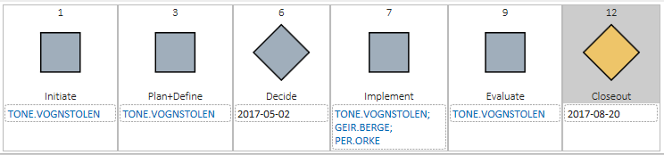
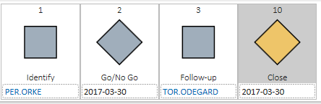
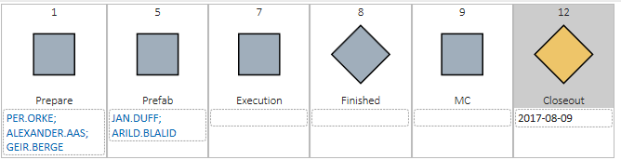
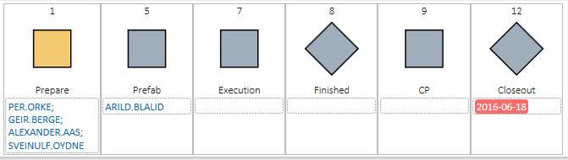
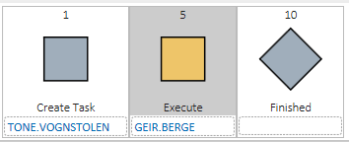
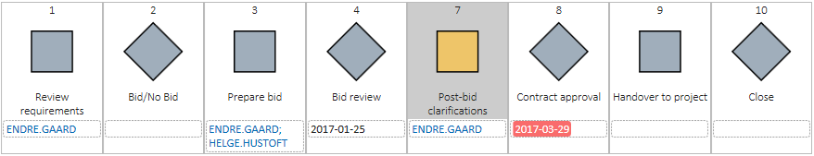
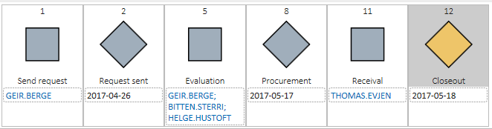
Project man. example
PURC
Punch
NonCon HSE impr.
Patent
SAMPLES
Change
Lead
WP / CP
Todo
Bid
REQ

Slide 31
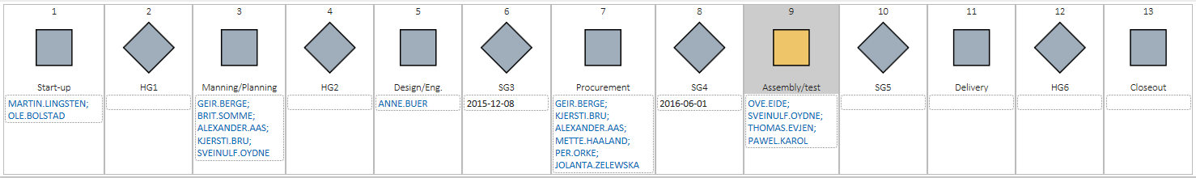

Project man. customer example
Doc
Action
Mail
REQ
Request for quotation to suppliers
Doc
Action
Mail
Punch
Purchase Orders to suppliers
PURC
Change
Doc
Action
Mail
Change management (variation orders)
Doc
Action
Mail
WP
Punch
Work Packages with Punches
Doc
Action
Mail
Doc
Action
Mail
Commissioning Packages with Punches
CP
Punch
Doc
Action
Mail

Slide 34
Action Module
Delivery Project Example (internal demo server)

Slide 35
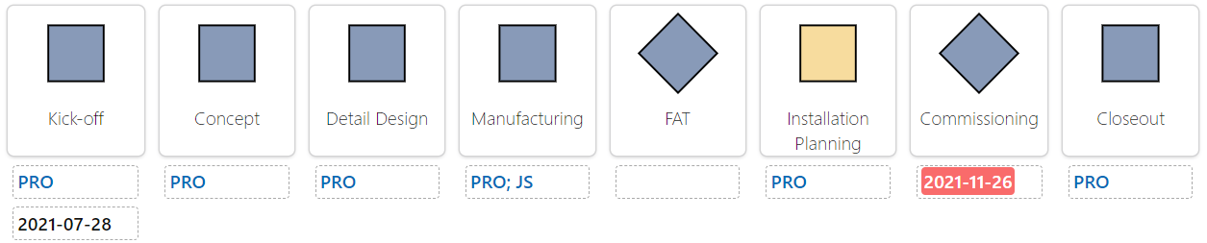
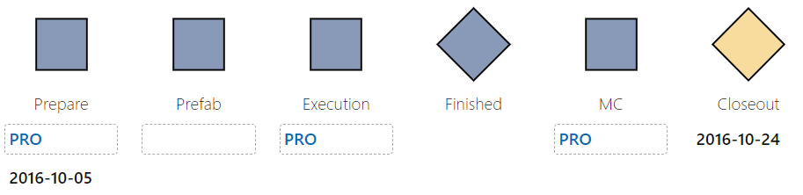
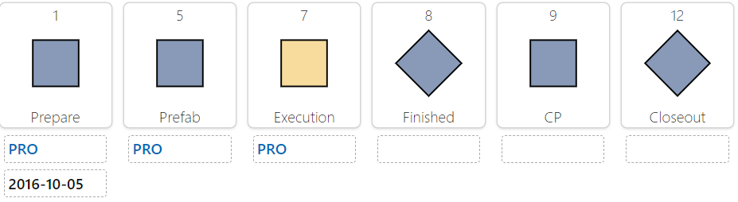
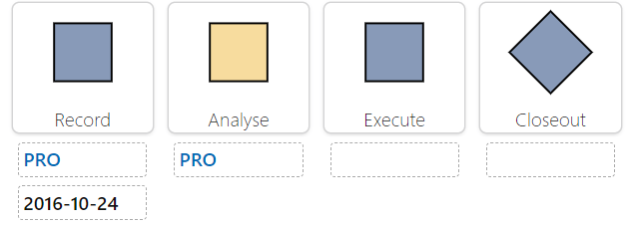
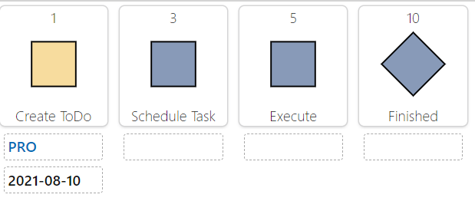
Delivery project demo example
Delivery project
Work Package
Commissioning Package
Punch
Task

Slide 36
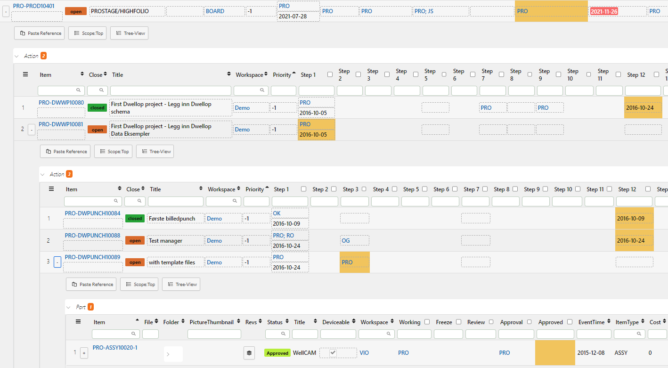
Delivery project demo example

Slide 37
Using the Action Module

Slide 38
Using Action
Create an Action ()
Action Types
Completing an Action (Assigning resources, progressing, completing)
Searching for Actions.
Parameters and Settings
Mandatory fields forward
Access and Permissions

Slide 39
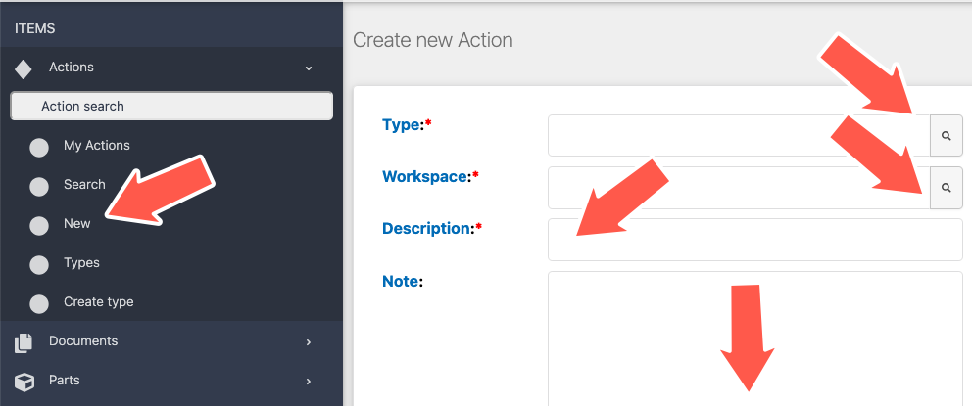
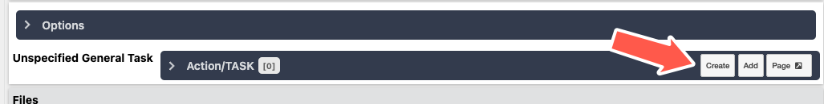
Create an Action
Create new Action in menu
Fill inn Type, Workspace and Description
Click the Create button
Alternatively, add sub-Actions where available

Slide 40
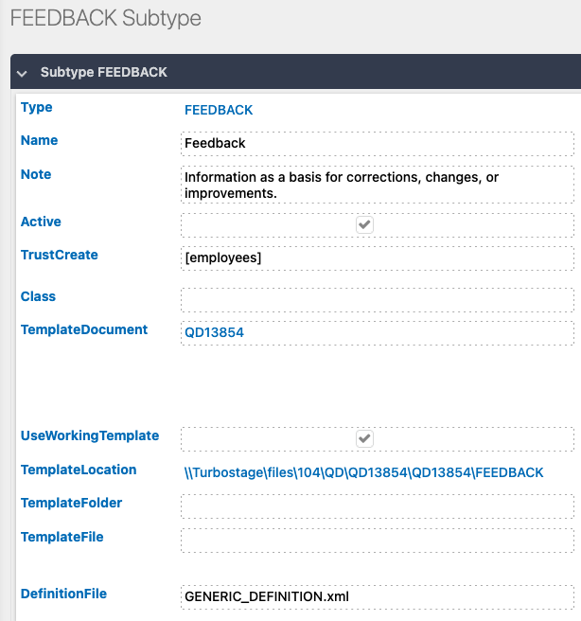
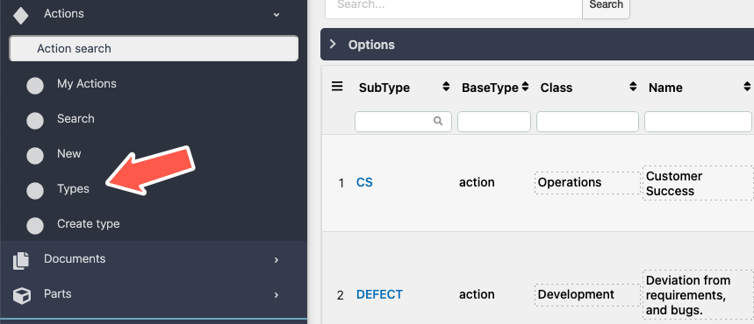
Action Types
List of types in the same way as for documents or parts
Similar functionality as for other item types
Content of Action coded in XML schema

Slide 41
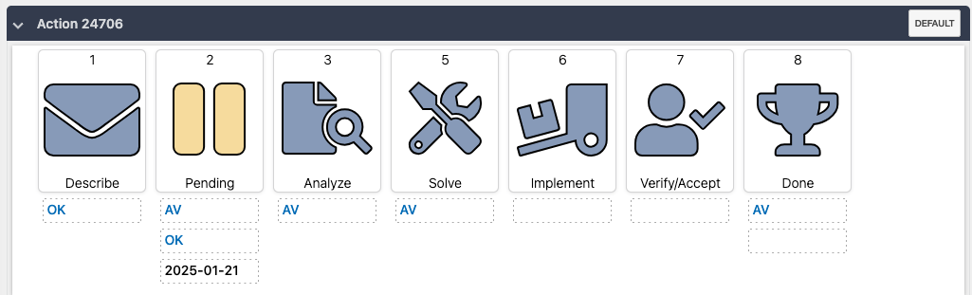


Completing an Action
Fill in info requested when the action opens
Initial page may have header info in additional step info
When Completing the step, progress by one of:
  Click the Step to <Next step>
  Click the step in the graphical representation
When complete, do click Close

Slide 42

Searching for Actions
Search works in the same manner as for Documents with some extensions
Under options the search may be limited to
  Who is engaged in the action
  Time window for the actions, here shown open now and forward
phases are listed with generic names
To present specific phase names, use the Item type definition =<subtype>, in this case =task

Slide 43


Parameters and Settings
Many of the parameters and settings from Doc applies
The squares represent activities. Its date indicates when it was entered.
Diamonds are milestones and user may define a date. Otherwise, it will be recorded when first visited.
Other standard items may be defined in the header.

Slide 44

Mandatory fields forward
Mandatory fields are marked with the red asterix *
You may not close the action if there are any blank mandatory fields in current or any previous steps
Workaround: Move back to latest step before first mandatory field and then close.

Slide 45


Access and Permissions
Action access managed under Base types
Subtype access managed in the same way as for Docs
Data access managed through workspace

Slide 46

ONE
SIZE
NEVER
FITS
ALL

